Slide 1
Definition
It is concerned with planning, organizing and controlling the flow of materials from their initial purchase through internal operations to the service point through distribution.
OR
Material management is a scientific technique, concerned with Planning, Organizing &Control of flow of materials, from their initial purchase to destination.

Slide 2
AIM OF MATERIAL MANAGEMENT
To get
1. The Right quality
2. Right quantity of supplies
3. At the Right time
4. At the Right place
5. For the Right cost

Slide 3
PURPOSE OF MATERIAL MANAGEMENT
To gain economy in purchasing
To satisfy the demand during period of replenishment
To carry reserve stock to avoid stock out
To stabilize fluctuations in consumption
To provide reasonable level of client services

Slide 4
Objective of material management
Primary
Right price
High turnover
Low procurement
& storage cost
Continuity of supply
Consistency in quality
Good supplier relations
Development of personnel
Good information system
Secondary
Forecasting
Inter-departmental harmony
Product improvement
Standardization
Make or buy decision
New materials & products
Favorable reciprocal relationships

Slide 5
Economy in material management
Containing the costs
Instilling efficiency in all activities

Slide 6
Four basic needs of Material management
To have adequate materials on hand when needed
To pay the lowest possible prices, consistent with quality and value requirement for purchases materials
To minimize the inventory investment
To operate efficiently

Slide 7
Basic principles of material management
Effective management & supervision
It depends on managerial functions of
Planning
Organizing
Staffing
Directing
Controlling
Reporting
Budgeting
2. Sound purchasing methods
3.Skillful & hard poised negotiations
4.Effective purchase system
5.Should be simple
6.Must not increase other costs
7.Simple inventory control programme

Slide 8
Elements of material management
Demand estimation
Identify the needed items
Calculate from the trends in Consumption during last 2 years.
Review with resource constraints

Slide 9
Functional areas of material management
1. Purchasing
2. Central service supply
3. Central stores
4. The print shops
5. The pharmacy
6. Dietary
& Linen services

Slide 10
PROCUREMENT
1. Directorate general of supply & disposal (DGS & D, Govt. Of India]
2. Medical stores depot (M. S.D. Government of India, Ministry of H & FW]
3. Private or public sector undertakings.
4. Receiving donations.

Slide 11
Procurement cycle
    Review selection
    Determine needed quantities
    Reconcile needs & funds
    Choose procurement method
    Select suppliers
    Specify contract terms
    Monitor order status
    Receipt & inspection

Slide 12
Objectives of procurement system
Acquire needed supplies as inexpensively as possible
Obtain high quality supplies
Assure prompt & dependable delivery
Distribute the procurement workload to avoid period of idleness & overwork
Optimize inventory management through scientific procurement procedures

Slide 13
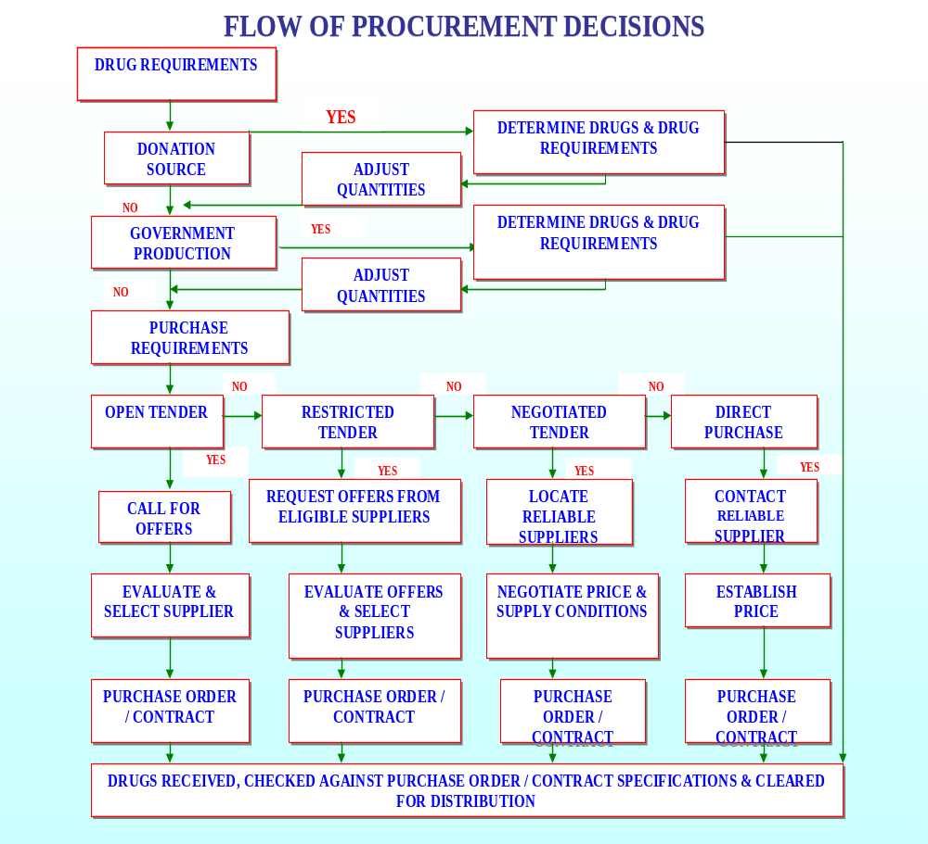

Slide 14
Open tender
Public bidding, resulting in low prices
Published in newspapers
Term - 4 weeks
Quotations must be sent in the specific forms that are sold, before the time &date mentioned in the tender form
In technical items, ‘two packets or two bins’ system is followed. Offers are given in two separate packets.
Technical bid
Financial bid
Cont……

Slide 15
First technical bid is opened & short listed
Then financial bid of selected companies are opened & lowest is selected
Delayed tenders & late tenders are not accepted. But if, in case of delayed tenders, if the rate quoted is very less, then it can be accepted.
Quotations are opened in presence of indenting department, accounts & authorized persons of party
Validity of tenders – generally 90 days

Slide 16
Earnest money
2 % of the tender amount or as decided has to be paid along with all quotations. In case of default 1/5 is withheld
Restricted or limited tender
From limited suppliers (about 10)
Lead-time is reduced
Better quality
Negotiated procurement
Buyer approaches selected potential Suppliers & bargain directly
Used in long time supply contracts
Direct procurement
Purchased from single supplier, at his quoted price
Prices may be high
Reserved for proprietary materials, or low priced, small quantity & emergency purchases

Slide 17
Rate contract
Firms are asked to supply stores at specified Rates during the period covered by the Contract
Spot purchase
It is done by a committee, which includes an officer from stores, accounts & purchasing departments
Risk purchase
If supplier fails, the item is purchased from other agencies & the difference in cost is recovered from the first supplier

Slide 18
Points to remember while purchasing
Proper specification
Invite quotations from reputed firms
Comparison of offers based on basic price, freight & insurance, taxes and levies
Quantity & payment discounts
Payment terms
Delivery period, guarantee
Vendor reputation
(reliability, technical capabilities, Convenience, Availability, after-sales service, sales assistance)
Short listing for better negotiation terms
Seek order acknowledgement

Slide 19
Storage
Store must be of adequate space
Materials must be stored in an appropriate place
in a correct way
Group wise & alphabetical arrangement helps in
identification & retrieval
First-in, first-out principle to be followed
Monitor expiry date
Follow two bin or double shelf system, to avoid
Stock outs
Reserve bin should contain stock that will cover
lead time and a small safety stock
Issue & use
Can be centralized or decentralized

Slide 20
Inventory control
It means stocking adequate number and kind of stores, so that the materials are available whenever required and wherever required. Scientific inventory control results in optimal balance

Slide 21
Functions of inventory control
To provide maximum supply service, consistent with maximum efficiency & optimum investment.
To provide cushion between forecasted & actual demand for a material

Slide 22
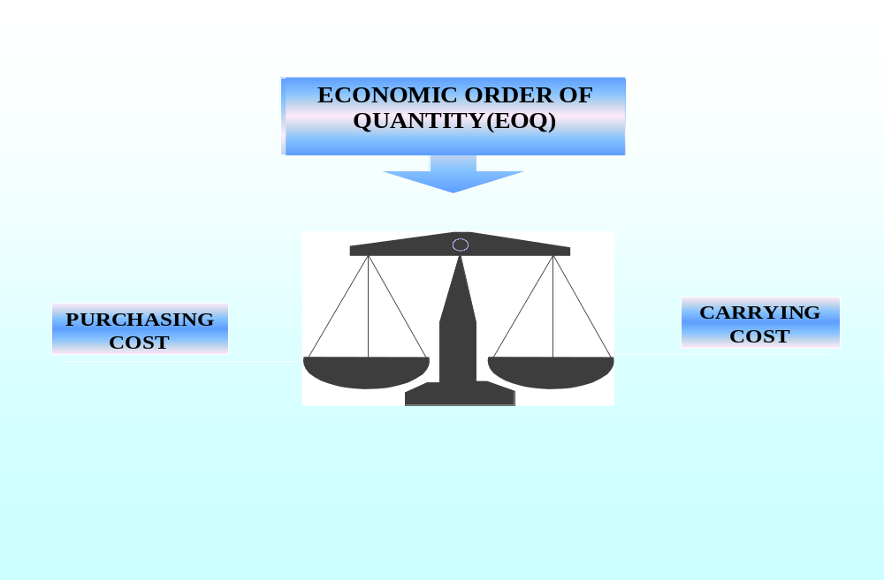
Economic order of quantity
EOQ = Average Monthly Consumption X Lead Time [in months] + Buffer Stock – Stock on hand

Slide 23
Re-order level: stock level at which fresh order is placed.
Average consumption per day x lead time + buffer stock
Lead time: Duration time between placing an order & receipt of material
Ideal – 2 to 6 weeks.

Slide 24
ABC ANALYSIS
(ABC = Always Better Control)
This is based on cost criteria.
It helps to exercise selective control when confronted with large number of items it rationalizes the number of orders, number of items & reduce the inventory.
About 10 % of materials consume 70 % of resources
About 20 % of materials consume 20 % of resources
About 70 % of materials consume 10 % of resources

Slide 25
‘A’ ITEMS
  Small in number, but consume large amount of resources
  Must have:
    Tight control
    Rigid estimate of requirements
    Strict & closer watch
    Low safety stocks
    Managed by top management

Slide 26
‘C’ ITEMS
Larger in number, but consume lesser amount of resources
Must have:
    Ordinary control measures
    Purchase based on usage estimates
    High safety stocks
    ABC analysis does not stress on items those are less costly but may be vital

Slide 27
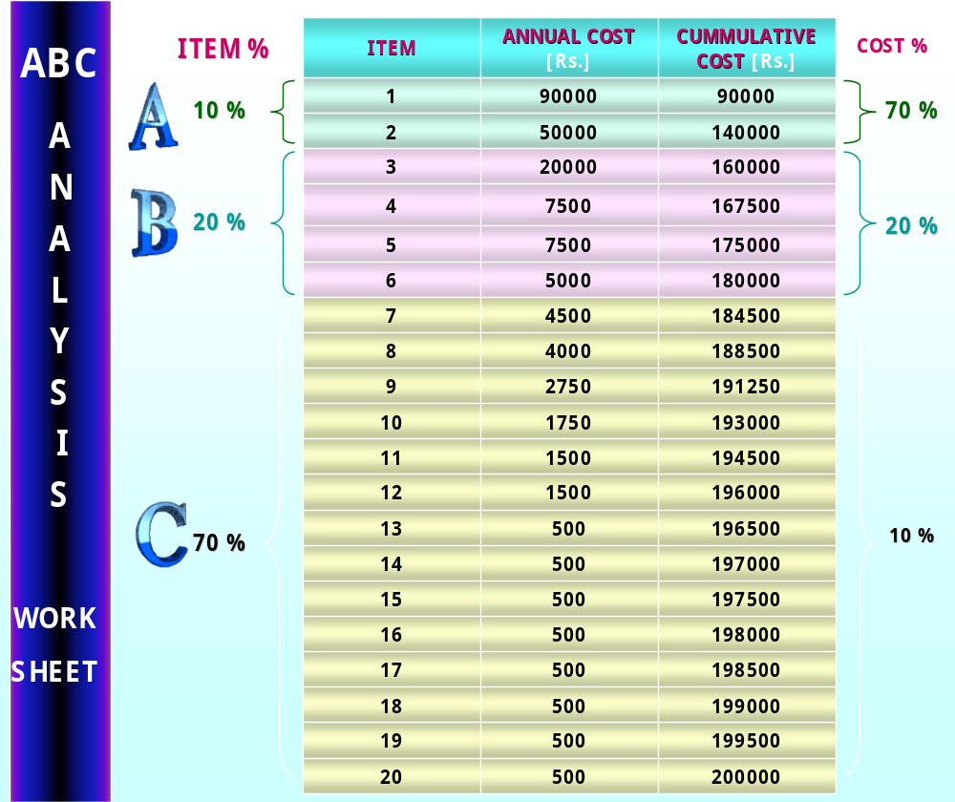

Slide 28
‘B’ ITEM
Intermediate
Must have:
    Moderate control
    Purchase based on rigid requirements
    Reasonably strict watch & control
    Moderate safety stocks
    Managed by middle level management

Slide 29
VED ANALYSIS
Based on critical value & shortage cost of an item
  It is a subjective analysis.
    Items are classified into:
Vital:
    Shortage cannot be tolerated.
Essential:
    Shortage can be tolerated for a short period.
Desirable:
    Shortage will not adversely affect, but may be using more resources. These must be strictly Scrutinized
 | V | E | D |  | ITEM | COST
A | AV | AE | AD | CATEGORY 1 | 10 | 70%
B | BV | BE | BD | CATEGORY 2 | 20 | 20%
C | CV | CE | CD | CATEGORY 3 | 70 | 10%
CATEGORY 1 - NEEDS CLOSE MONITORING & CONTROL
CATEGORY 2 - MODERATE CONTROL.
CATEGORY 3 - NO NEED FOR CONTROL

Slide 30
SDE ANALYIS
Based on availability
  Scarce
    Managed by top level management
    Maintain big safety stocks
  Difficult
    Maintain sufficient safety stocks
  Easily available
    Minimum safety stocks
FSN ANALYSIS
      Based on utilization.
      Fast moving.
      Slow moving.
      Non-moving.
      Non-moving items must be periodically reviewed to prevent expiry
      & obsolescence
HML ANALYSIS
Based on cost per unit
Highest
Medium
Low
This is used to keep control over consumption
at departmental level for deciding the frequency of physical verification.

Slide 31
PROCURMENT OF EQUIPMENT
Points to be noted before purchase of an equipment:
  Latest technology
  Availability of maintenance & repair facility, with minimum down time
  Post warranty repair at reasonable cost
  Upgradeability
  Reputed manufacturer
  Availability of consumables
  Low operating costs
Installation
Proper installation as per guidelines

Slide 32
HISTORY SHEET OF EQUIPMENT:
History sheet
Name of equipment Code number Date of purchase Name of supplier Name of manufacturer Date of installation Place of installation Date of commissioning Environmental control Spare parts inventory Techn. Manual / circuit diagrams / literatures | After sales arrangement Guarantee period Warranty period Life of equipment Down time / up time Cost of maintenance Unserviceable date Date of condemnation Date of replacement

Slide 33
  Maintenance sheet:
  Annual maintenance contract [AMC]
    Starting date
    Expiry date
    Service / repair description
    Materials / spares used
    Cost of repairs
        In-house
        Outside agency

Slide 34
EQUIPMENT MAINTENANCE & CONDEMNATION
        Maintenance & repairs:
        Preventive maintenance
        Master maintenance plan
        Repair of equipment

Slide 35
Meaning of Store Management
A store must be exciting in all respects to be able to motivate the customer to visit it again and again. Many retailers around the world prefer to implement the strategy of a ‘store as theatre’ concept and conceive their store as a theatre itself where the items of merchandize can be equated, the characters of a play and the lights and visual communication treated as the sets.
Store managers are responsible for increasing the productivity of two of the retailers most important assets; the firm’s investments in the employees and in Real Estates.
While designing a store, retailers must consider the seven fundamental objectives detailed below:

Slide 36
STORE DESIGN
The term ‘design’ has been variously defined as a plan or scheme used to denote the end results particularly the appearance of a design process.
Design has also been used to denote the outward appearance or physical arrangement of objects involving shapes, layouts, colors, textures and in sensory dimensions.
Retail store design acts on the conscious and subconscious level, and has an effect upon the consumer’s perceptions of a brand or retailer.

Slide 37
STORE DESIGN
Thus, the concept of retail store design or ‘retail design’ covers all aspects of the design of a store: ranging from store frontage, fascia and signage, to the internal elements of furniture, merchandising, display, lighting, graphics, point of sale and decoration.

Slide 38
Objectives of a good Store Design
Consistency with store image: Both the internal and external design and decoration of the store must be consonance with the image of store and what it wishes to communicate to the general public.
Selection of a family of fixtures: while it is essential to design a store layout that is consistent with the stores image, it is also essential that the type of fixtures used must be similar to each other or belong to the same family. Example: if the retailer uses wooden, he should avoid using sheet metal shelving rocks.
Need to influence customer shopping: It would be prudent for a retailer to constantly evaluate his store layout and visual merchandising techniques in terms of the impact that it might have in influencing the customer’s decisions

Slide 39
Objectives of a good Store Design
4. Returns on Investments: A retailer must be certain that all his decisions ensures proportionate returns and that the recurring costs and hassles of maintenance are also affordable.
5. Must be modular: Every store in the world needs a periodic change in its design as customers are bound to get bored and need to be attracted by an exciting store design.
6. Cost – Effectiveness: All electrical equipment used in the store must be energy – efficient as energy costs a major component of recurring expenditure in a retail operation.
7. Optimization of Floor Space: While designing a store, retail planners must strike an ideal balance between optimizing floor space and encouraging customer traffic flow.

Slide 40
STORE LAYOUT
A layout is like a plan for the store. It is meant to aid movement and flow of customers, so that they move through the entire store. Areas within the store need to be demarcated as prime selling areas, impulse merchandize areas, destination areas and seasonal or special merchandize areas.
The entrance area of the store is often referred to as the ‘decompression zone’ or the ‘transition zone’. This is the area near the entrance to the store. When the customer enters the store, he is making a transition to a new environment.
The layout of the store would vary across retailers
Typically, store layouts may be classified into:
  Grid Store Layout
  Racetrack Store Layout and
  Freeform Store Layout

Slide 41
GRID STORE LAYOUT
The grid layout is the one most commonly used in supermarkets, grocery and discount stores. While one area of display is along the walls of the stores, the other merchandize is displayed in a parallel manner. It allows for movement within the area and uses space effectively.
A part from this, it is also cost – effective in both in terms of the cost of the shelving racks used as well as the extent of wastage of prime space.

Slide 42
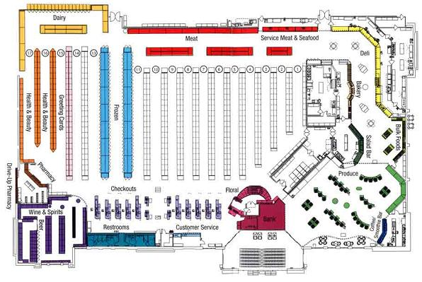
GRID STORE LAYOUT

Slide 43
RACE TRACK STORE LAYOUT
Also called as loop layout. As the name suggests, the display is in the form of a racetrack or a loop, with a major aisle running through store. The aisle provides access to various shop-in-shops or departments within the store. This layout is popularly found in department stores. A racetrack layout used in department stores is usually a category/department-wise layout in which ever manufacturer is allotted a separate space.

Slide 44
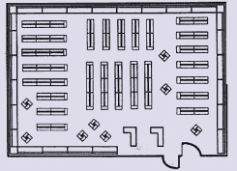
RACE TRACK STORE LAYOUT

Slide 45
FREE FORM STORE LAYOUT
In a free form, merchandize is arranged in an asymmetrical manner. This type of store is more popular in specialty stores. There is abundant open space with very little and selective furniture and fixtures, but of very expensive tastes.

Slide 46
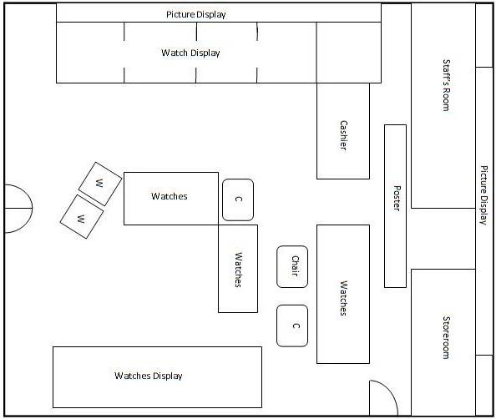
FREE FORM STORE LAYOUT

Slide 47
ATMOSPHERICS
Refers to the design of an environment to stimulate customers perceptual, emotional responses and ultimately to affect their purchase behavior. The atmospherics are as follows:
Visual Communications
Lighting
Color
Music
Scent/ Smell

